Slide 1

INFRASTRUCTURE & ENGINEERING:
WATER AND SANITATION
ALGOA WATER SUPPLY SYSTEM RESTRICTIONS MONITORING MEETING
14 August 2017

Slide 2

CONTENTS
INTRODUCTION AND PURPOSE
ANALYSIS OF THE AVAILABLE WATER
MEASURES TO REDUCE WATER CONSUMPTION
CONCLUSIONS AND RECOMENDATIONS
PROJECT READINESS MATRIX
FINANCIAL IMPLICATIONS OF INTERVENTIONS
MEASURES TO INCREASE WATER SUPPLY

Slide 3
INTRODUCTION AND PURPOSE
NMBM is experiencing one of worst droughts in history.
Dam levels have now dropped to below 32%.
Below average rainfall is predicted for the next rain period.
Restrictions imposed in Sept. 2016 with Par C in May 2017.
Drought Disaster declared on 22 May 2017 by the Exec Mayor i.t.o. Section 55 of Disaster Man. Act and awaiting Provincial Gazetting.
Estimated 1 Year of water left with Dams reaching dead storage by Aug. 2018 (if no inflow).
Purpose of the report:
  Illustrate the severity of drought
  Indicate the status of the water sources
  Show the mitigation measures to reduce demand and to increase the available water supply
Detailed Emergency Action Plan being finalised.

Slide 4
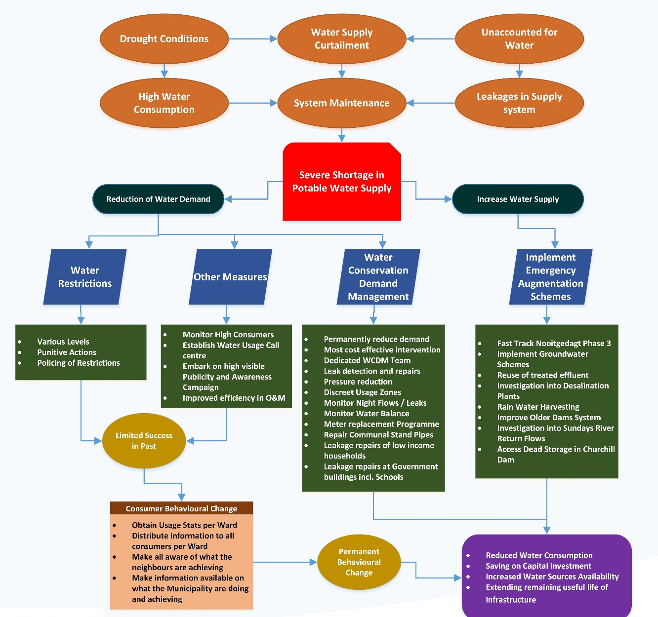
INTRODUCTION AND PURPOSE
The figure below demonstrates the Drought Implementation Strategy being Implemented:
Measures to reduce water demand
  Implementation of water restrictions
  Public awareness and improved operations & maintenance
  Water conservation and demand management
Measures to increase water supply
  Implementation of emergency augmentation schemes

Slide 5
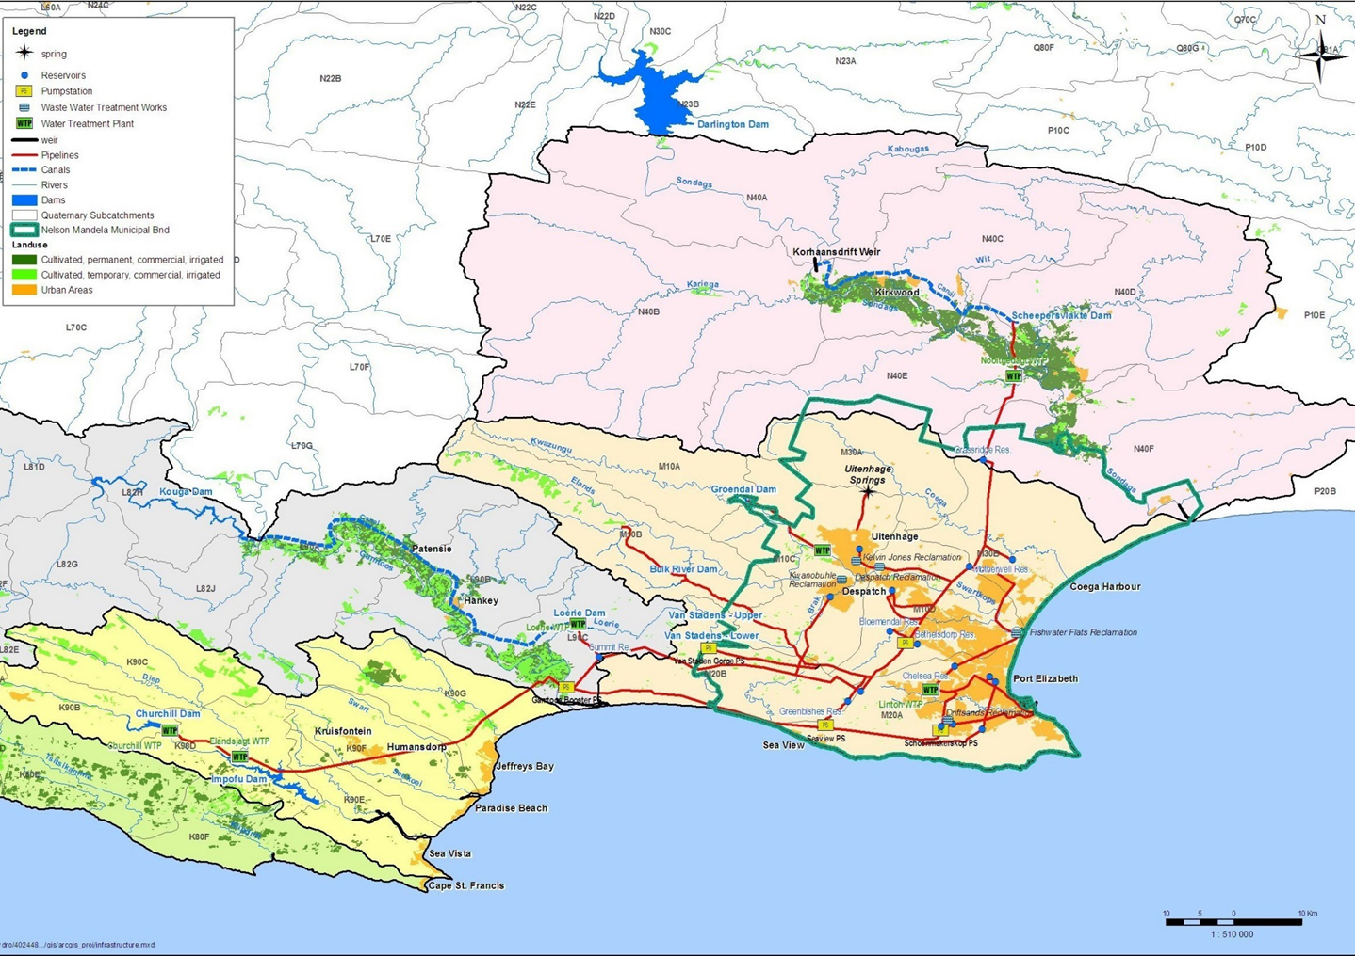
ANALYSIS OF AVAILABLE WATER
Diagrammatic Layout of NMBM Bulk Water Supply

Slide 6
ANALYSIS OF AVAILABLE WATER
NMBM Water Supply – licenced available abstraction
Source | Normal Licenced Abstraction (Ml/d) | DWS Restricted Abstraction (%) | Restricted Abstraction (Ml/d) | Water Treatment Losses (%) | Allowable Water Produced (Ml/d)
Churchill Dam | 55 | 25 | 41.3 | 12.7 | 36
Impofu Dam | 49.3 | 25 | 37 | 5.3 | 35
Loerie Dam | 63 | 25 | 47.3 | 0.1 | 47.2
Sundays - Nooitgedagt WTW | 160 | 0 | 140 | 1.5 | 137.9
Older Dams | 7 | 0 | 0 | 6.35 | 6.5
Groendal Dam | 8.4 | 25 | 6.3 | 2 | 6.2
Springs | 5.9 | 0 | 6 | 0 | 6
Total | 348.6 |  | 277.9 |  | 274.8
Current NMBM Dam Levels (End July 2017)
NMBM Dam Levels (%)
Churchill Dam | 7.47
Impofu Dam | 57.47
Loerie Dam | 58.53
Groendal Dam | 50.17
Kouga Dam | 14.66
Total | 31.78

Slide 7
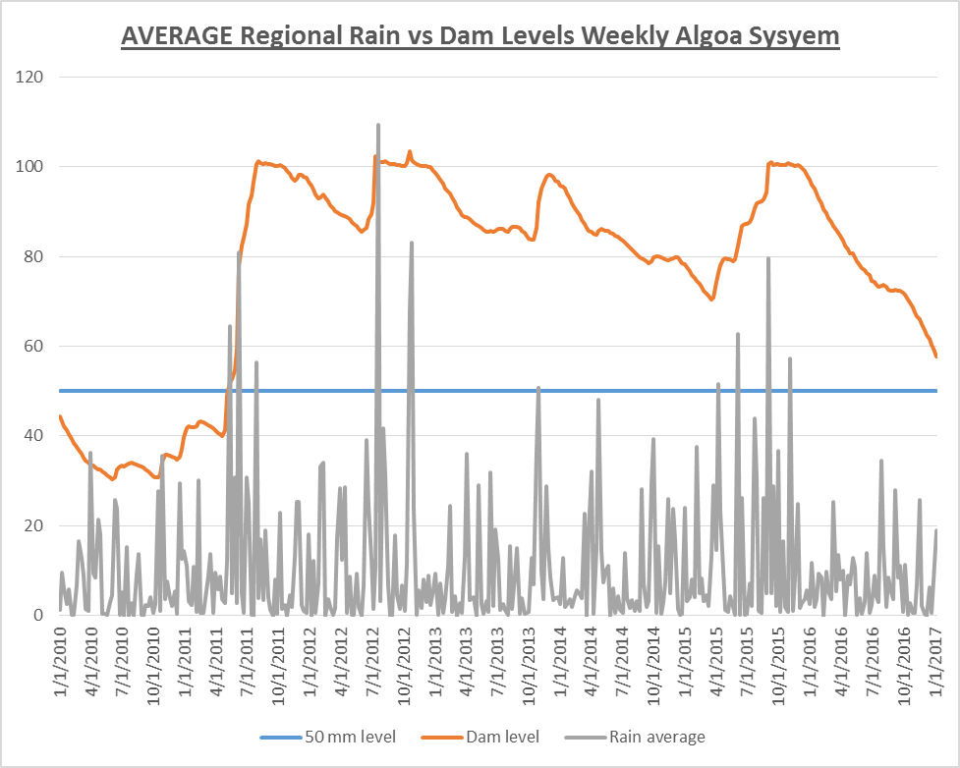
50 mm Rainfall & Above

Slide 8
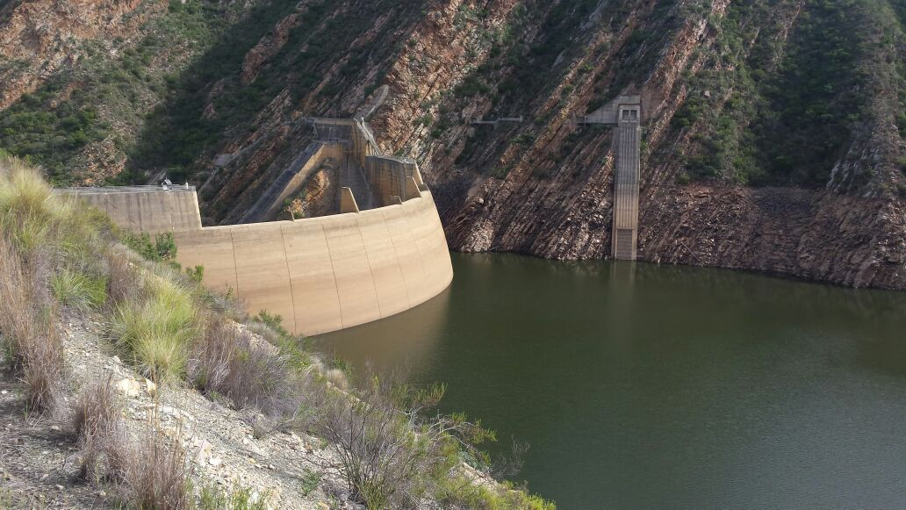
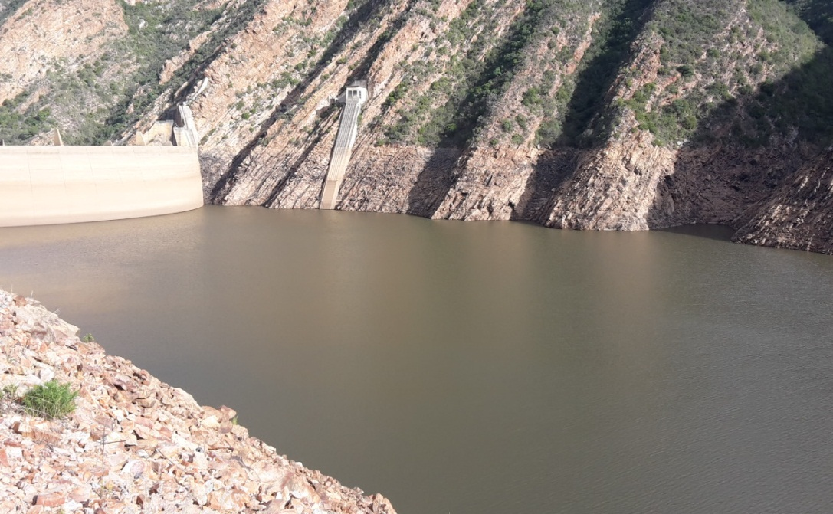
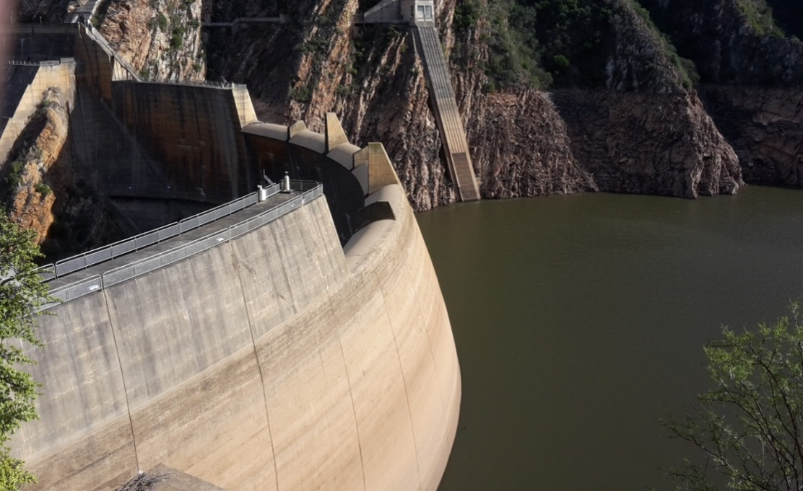
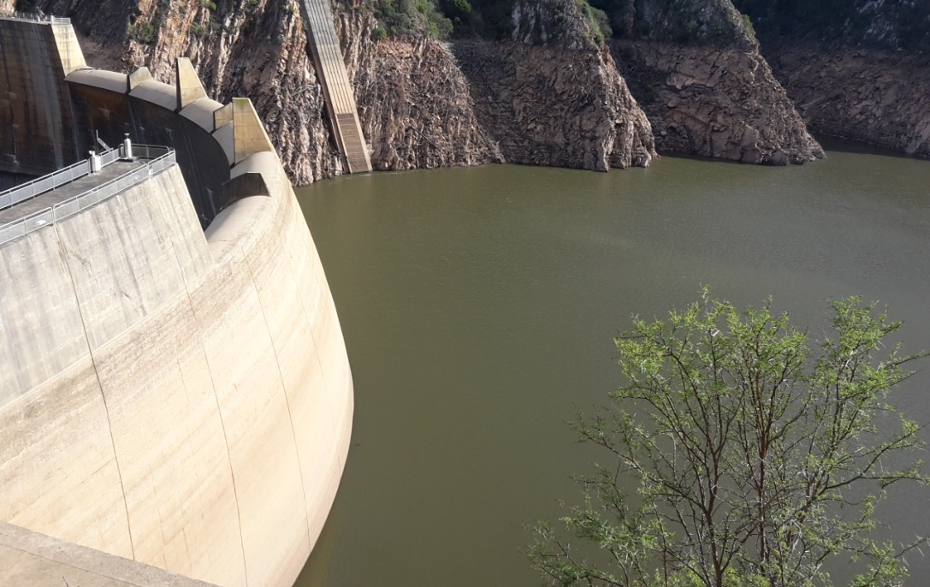
ANALYSIS OF AVAILABLE WATER
Kouga Dam Status

Slide 9
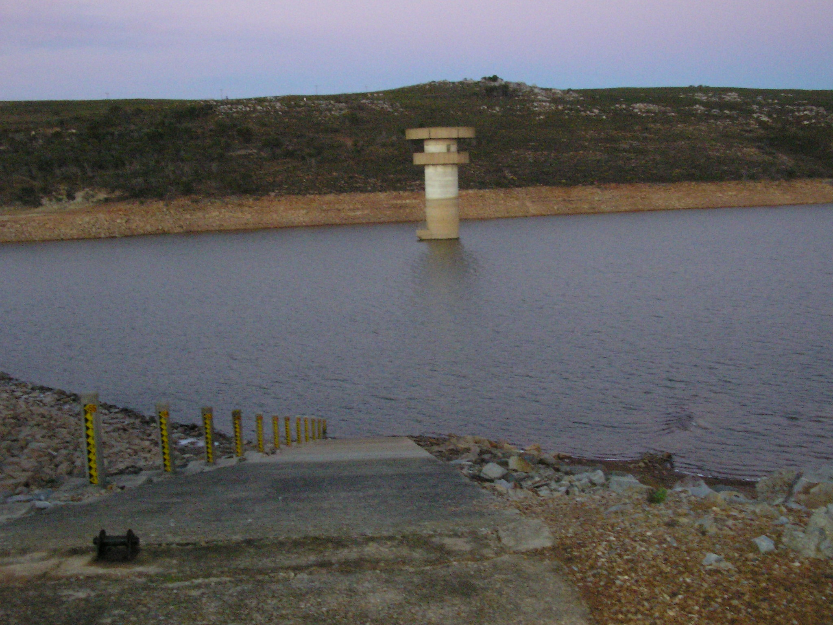
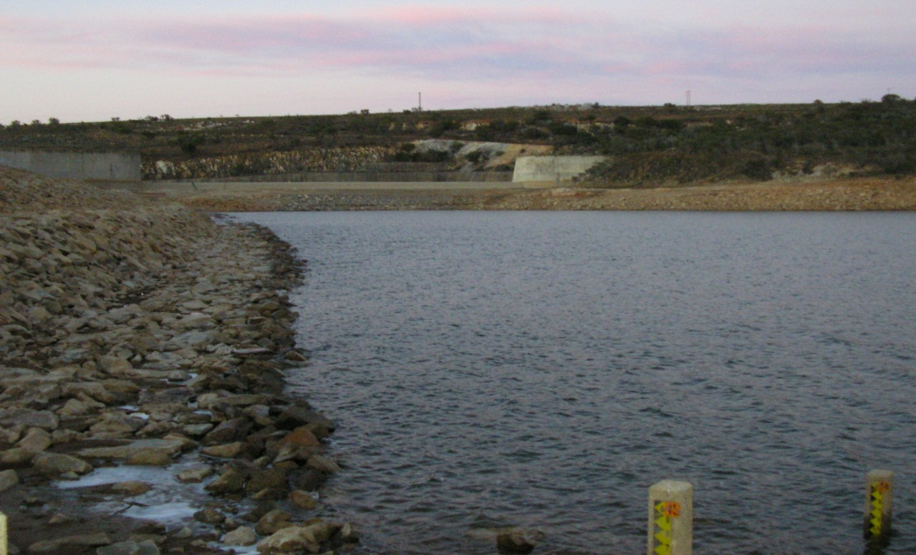
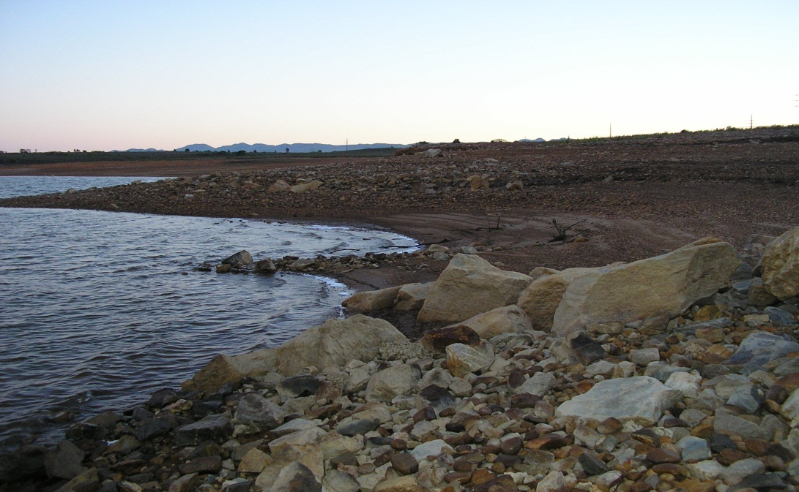
ANALYSIS OF AVAILABLE WATER
Impofu Dam Status

Slide 10
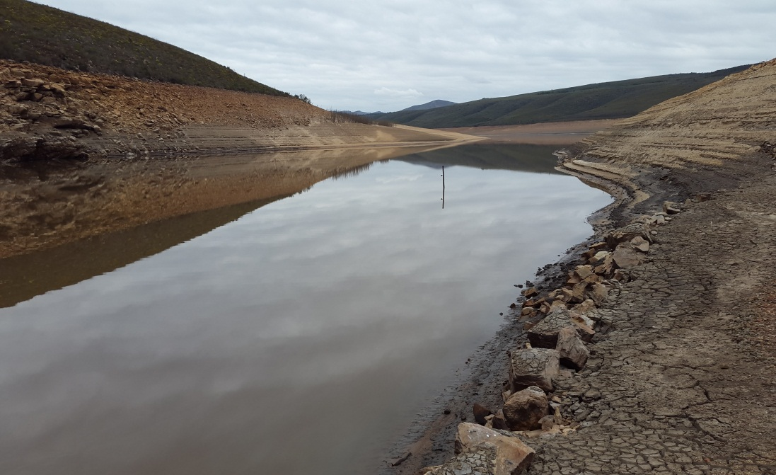
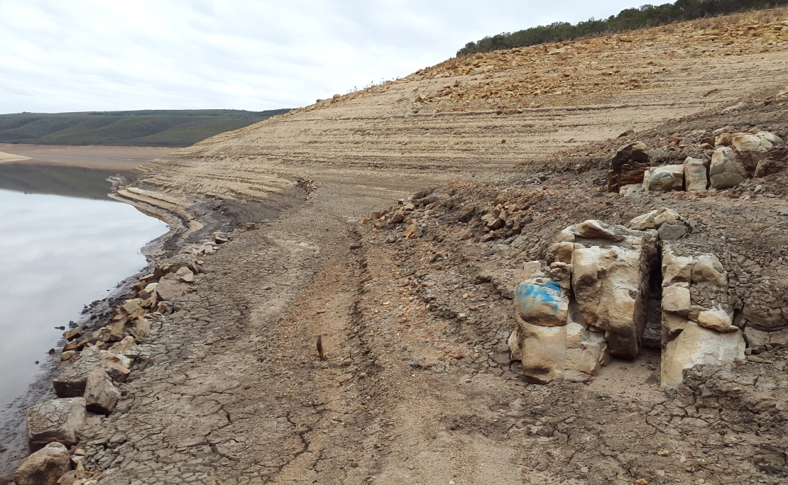
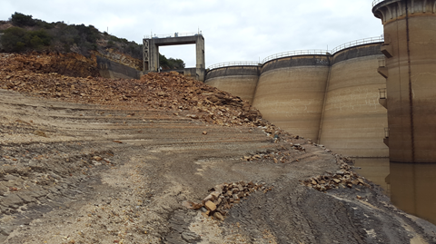
ANALYSIS OF AVAILABLE WATER
Churchill Dam Status

Slide 11
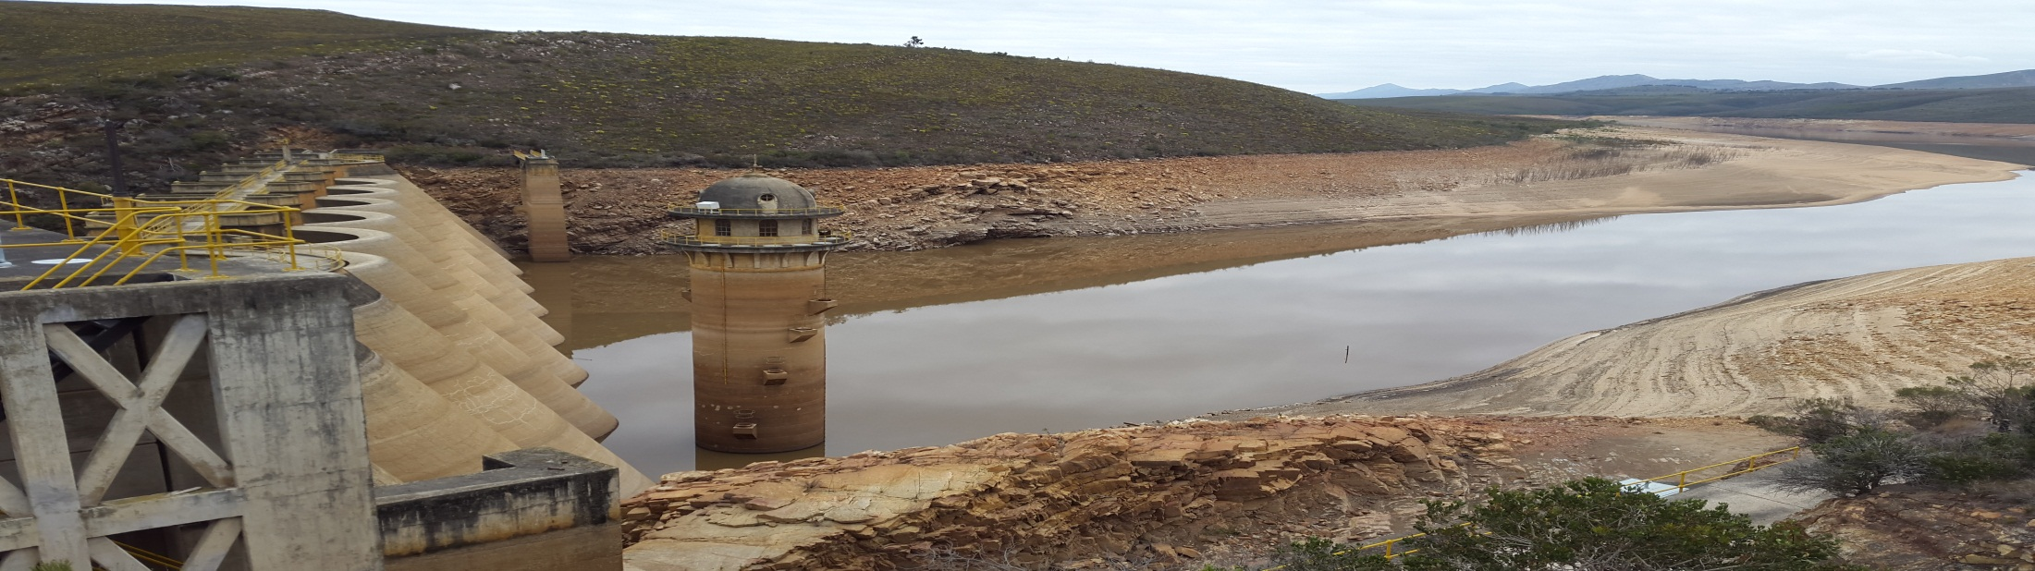
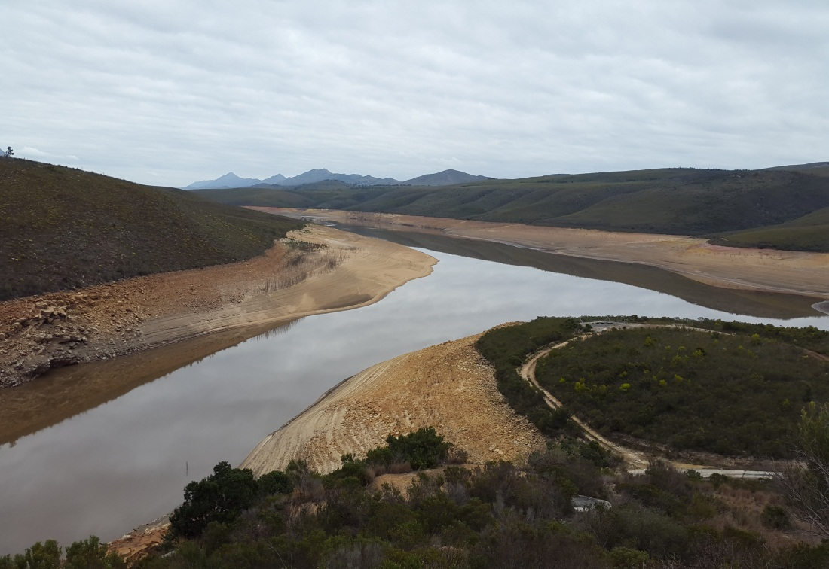
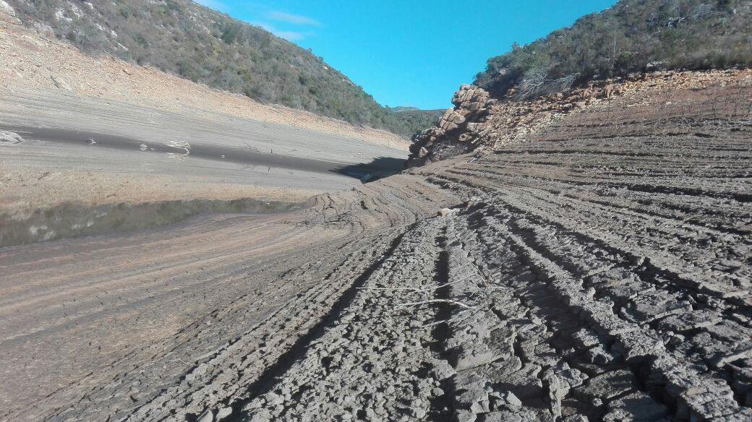
ANALYSIS OF AVAILABLE WATER
Churchill Dam Status

Slide 12
ANALYSIS OF AVAILABLE WATER
Historical Dam levels
Month | Kouga (%) | Churchill (%) | Impofu (%) | Loerie (%) | Groendal (%) | Total (%)
July 2016 | 65.38 | 63.45 | 83.93 | 33.58 | 80.15 | 72.58
August 2016 | 66.13 | 59.83 | 83.51 | 21.05 | 78.09 | 71.88
September 2016 | 65.8 | 60.71 | 82.93 | 23.83 | 79.12 | 71.70
October 2016 | 61.52 | 55.13 | 80.76 | 20.85 | 76.72 | 68.14
November 2016 | 55.76 | 49.57 | 79.18 | 20.26 | 73.71 | 64.17
December 2016 | 47.37 | 41.94 | 76.54 | 20.46 | 68.90 | 58.25
January 2017 | 40.88 | 35.13 | 73.98 | 32.55 | 65.81 | 53.53
February 2017 | 34.18 | 28.40 | 71.39 | 45.51 | 62.80 | 48.74
March 2017 | 28.38 | 20.88 | 69.32 | 41.54 | 59.02 | 44.23
April 2017 | 24.33 | 15.76 | 66.98 | 34.93 | 56.44 | 40.24
May 2017 | 20.74 | 12.35 | 64.63 | 55.98 | 54.81 | 37.85
June 2017 | 18.36 | 9.70 | 61.07 | 30.27 | 52.32 | 34.85
July 2017 | 15.18 | 7.67 | 58.3 | 29.44 | 49.14 | 31.99
% change | 50.2 | 55.78 | 25.63 | 4.14 | 31.01 | 40.59
MONTH | AVE. DAM LEVELS | %CHANGE | AVE MONTHLY CONSUMPTION (Mℓ/d)
July 2016 | 72.58 | 1.43 | 307.91
August 2016 | 71.88 | 0.70 | 314.77
September 2016 | 71.70 | 0.18 | 305.60
October 2016 | 68.14 | 3.56 | 301.73
November 2016 | 64.17 | 3.97 | 303.73
December 2016 | 58.25 | 5.92 | 303.01
January 2017 | 53.53 | 4.72 | 293.53
February 2017 | 48.74 | 4.79 | 293.02
March 2017 | 44.23 | 4.51 | 288.00
April 2017 | 40.24 | 3.99 | 284.02
May 2017 | 37.85 | 2.39 | 258.99
June 2017 | 34.85 | 3 | 267.60
July 2017 | 31.99 | 2.86 | 269.48
Overall Monthly Storage Capacities

Slide 13
ANALYSIS OF AVAILABLE WATER
Current and Predicted Dam Levels

Slide 14
ANALYSIS OF AVAILABLE WATER
Historical Bulk Water Consumption

Slide 15
ANALYSIS OF AVAILABLE WATER
20 Year Rainfall Data at Churchill Dam

Slide 16
MEASURES TO REDUCE CONSUMPTION
Water restrictions
  Originally imposed in September 2016
  Part C imposed in May 2017 for domestic and Part B for commercial and industrial
  25% Reduction of usage from Kromme and Kouga Schemes
  Clarity required on restrictions on Kouga 40%??? vs general 25%
More Severe Restrictions
  Determine Effectiveness of restrictions.
  By Law enforcement ito Chap 6 (Sections 65 – 75).
  Implement additional measures if not effective
    More intensive ongoing public awareness campaigns
    More intensive policing of restrictions and particularly the monitoring of high use consumers.
    Increased Restrictions
  Metro wide water restriction devices.

Slide 17
MEASURES TO REDUCE CONSUMPTION
3. Influencing Behavioural Change
  Consumers water demand returns to normal when restrictions are lifted
  Influence Consumers demand permanently to use less water
Return to previous consumption

Slide 18
MEASURES TO REDUCE CONSUMPTION
Disaster Declaration
  Reduction in Water consumption - When declaring a disaster
  The Gazetted Disaster declaration authorises NMBM to:
    Investigate & implement drought disaster relief strategies.
      The Exec. Mayor / Council can approve all matters related to this.
      Resources and funds can be reallocated in support.
      Application for Emergency Funds to support internal funds.

Slide 19
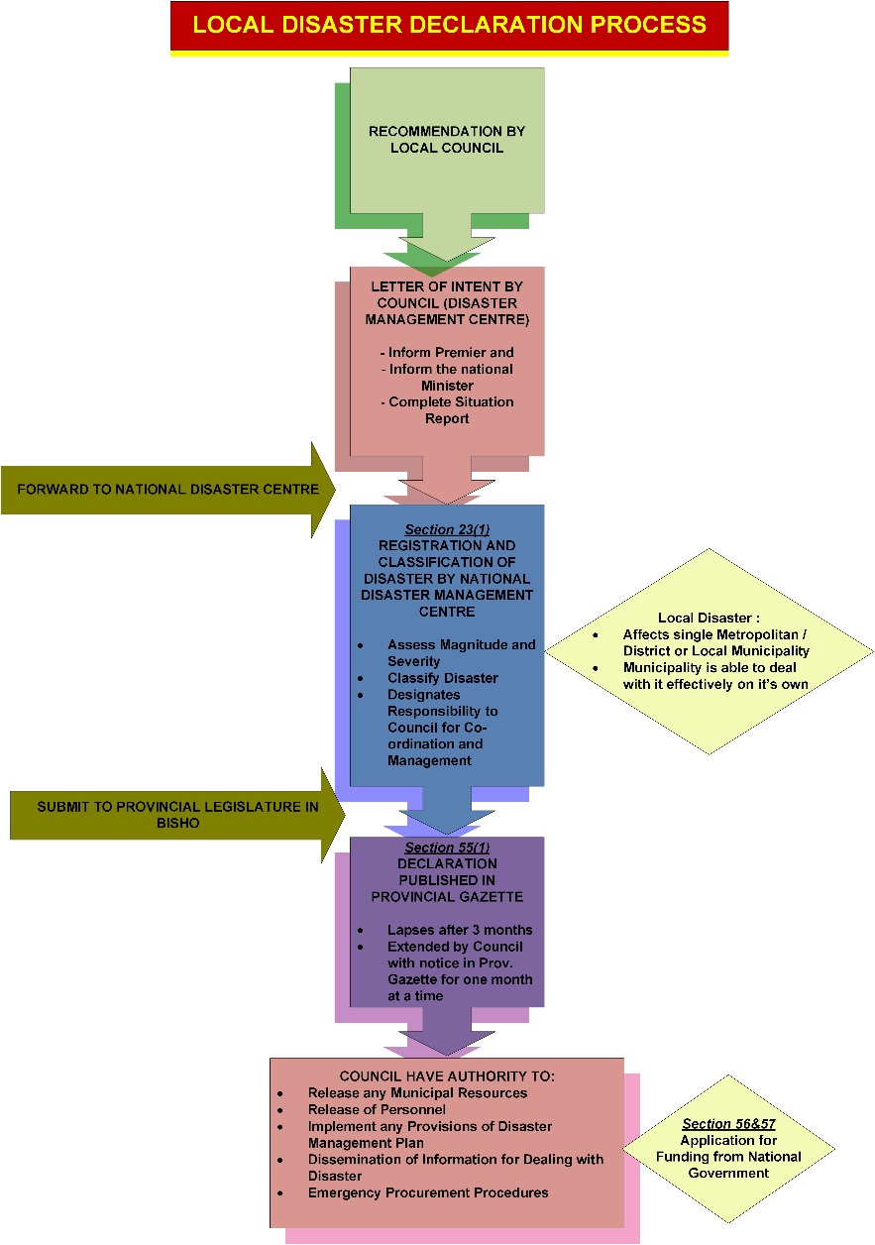
MEASURES TO REDUCE CONSUMPTION
Disaster Declaration Process

Slide 20
MEASURES TO REDUCE CONSUMPTION
Water Conservation and Water Conservation Demand Management:
  Note: - for 15/16 to 16/17 fn. yr.
  NRW reduced from 43.4% to 37.5% .
  Physical Water Losses reduced from 37.3% to 29.4%.
  Workstream 1: Bulk Supply Meters
    The installation of Bulk Meters to establish actual losses and to develop a water balance
  Workstream 2: GMA and DMA Meters
    The installation of GMA and DMA Meters to establish where most losses occur
  Workstream 3: Remote Metering
    The installation of GMA and DMA Meters to establish where most losses occur

Slide 21
MEASURES TO REDUCE CONSUMPTION
    Workstream 4: Non-Revenue Water (NRW)
      Summary of all the WC/WDM interventions
    Workstream 5: PRV Management
      Savings in water usage can be realised by applying pressure reduction
  Workstream 6: ICI Consumers and Billing Database
    Industrial and institutional consumers uses 42% of the total water. Special attention is given to these consumers
  Workstream 7: Water Tariffs
    An investigation was undertaken of the domestic water tariffs, commercial/industrial water tariffs and fixed charges of nine metropolitan municipalities for 2014/15 and 2015/16.

Slide 22
MEASURES TO REDUCE CONSUMPTION
    Workstream 8: Leak Repairs
    ATTP
    Schools
    Ward Clusters
    Leak Fixing festival
    Workstream 9: Repair and Maintenance
      Repairs picked up during water loss audits
    Workstream 10: Domestic Meter Audit and On-property leak Investigations
      Many meter readings are estimated and or are not on the billing system. An audit is being performed

Slide 23
MEASURES TO REDUCE CONSUMPTION
    Workstream 11: Valve and Fire Hydrant Audit
      Many valves and Fire Hydrants have faults and need to be repaired to reduce wastage of water.
    Workstream 12: Meter replacement Programme
      A meter replacement programme is part of this workstream
    Workstream 13: Publicity and Awareness Programme
      School Awareness Programme
      Drought Campaign
      Social facilitation
      Operational Call Centre

Slide 24
MEASURES TO REDUCE CONSUMPTION
Increased Efficiency in Operations and Maintenance
  Water as well as Revenue is lost due to water leaks.
  This can be minimised by investing in Operational Interventions.
  A Shortage in internal human and other resources is evident.
To mitigate the above, the following is proposed:
Management prioritise filling the resource gaps that exists within the depots.
The filling of the critical positions to be effected as a matter of urgency.
Procuring tools and equipment required for day to day operations of Water Distribution Workshops.
The Metro prioritises a fleet recapitalization programme to reduce downtime that adversely affect the efficiency of maintenance teams.

Slide 25
MEASURES TO INCREASE NMBM WATER SUPPLY
Several Augmentation Schemes have been identified of which some are currently being implemented whilst others are in planning stages:

Slide 26
FINANCIAL IMPLICATIONS OF INTERVENTIONS

Slide 27
PROJECT READINESS MATRIX

Slide 28
RECOMENDATIONS
The following recommendations are made:
Reduce water consumption through the drought campaign and further restrictions.
Maximisation of the use of water from the Gariep Dam treated at the Nooitgedagt Water Treatment Works (140 Ml/d).
Exploring ground water:
  Coega Kop
  Churchill
  “Reservoir” boreholes.
Extending WCDM interventions.
Fast tracking the Nooitgedagt Phase 3 contract.
Fast tracking the improvements to the Older Dams system:
  Construction of a booster pump station at Sandriver dam.

Slide 29
RECOMENDATIONS
Accessing dead storage water in the Churchill Dam.
Promote the use of private boreholes and rain water harvesting tanks.
Desalination:
  Western Scheme
  Coega Collaboration Scheme
  Marina Sea Salt Collaboration Scheme
Water and Sanitation By-Laws amendments for rainwater harvesting for:
  Filling of swimming pools
  Gardening
Continue with the investigation into the Sundays River Return flows.

Slide 30
RECOMMENDATIONS
Funding for proposed Drought Intervention – R7.017M
NO | INTERVENTION | COST | COMMENT
1 | Reduce water consumption through:
 | Drought campaign, possible further restrictions & By Law Enforcement | R 9,850,000
 | Further restrictions. |  | Areas affecting private households
 | Private boreholes
 | Rain water harvesting tanks.
2 | Maximisation of the use of water from the Gariep Dam treated at the Nooitgedagt Water Treatment Works. |  | Increase in operational cost because of eletricity & chemical costs.
3 | Exploring ground water and implementing temporary schemes. | R 351,000,000
4 | Extending WCDM interventions. | R 146,040,000
5 | Fast tracking the Nooitgedagt Phase 3 contract. | R 408,000,000 | 25% of contract value
6 | Fast tracking the improvements to the Older Dams system (Booster pump station at Sandriver dam). | R 49,500,000
7 | Accessing dead storage water in the Churchill Dam. | R 1,500,000
8 | Desalination:
 | Western Scheme | R 1,597,000,000
 | Coega Collaboration Scheme | R 1,600,000,000
 | Marina Sea Salt Collaboration Scheme | R 30,000,000
9 | Coega Return Effluent Scheme | R 763,000,000
10 | Sundays River Return Flows | R 975,000,000
11 | Fishwater Flats to Loerie Reclaimed effluent Scheme | R 980,000,000
12 | Increased Effieciency for Operations & Maintenance | R 105,900,000
 |  | R 7,016,790,000

Slide 31
OBSERVATION
The drought intervention funding is large however:
  Algoa supply system experiences a drought once every 4 years.
  Not all 2009-2011 drought interventions were implemented due to funding shortage.
NCLLS was the main water augmentation / drought mitigation project.
  Funding only received for Phase 1 (R450M).
  Phase 2 Currently being completed.
  Phase 3 just commenced & due for completion in 2019.
If the funding application for the NCLLS was supplied fully the current water shortage would have been delay by at least 1-2 yrs.

Slide 32
OBSERVATION
Impact of the additional 50 Ml/d from NCLLS (140 Ml/d):
  Churchill WTW stopped.
  Loerie WTW stopped.
  Chelsea zone increased.
  System redundancies being utilised:
    Transfer of water from east to west via Motherwell & Stanford Rd Boosters.
    Water pumped towards:
      Summit to feed KwaNobuhle
      Greenbushes

Slide 33

General Layout of Metro Bulk Water Supply

Slide 34

General Layout of Metro Bulk Water Supply
Sundays / Nooitgedagt
70 Ml/d
Groendal /Springs
17 Ml/d
Older Dams
10 Ml/d
Kouga / Loerie
NMBM
270 Ml/d
64 Ml/d
Churchill / Impofu
122 Ml/d

Slide 35

Possible Future Scenario
Sundays / Nooitgedagt
More Severe Water Restrictions
Boreholes
140 Ml/d
20 Ml/d
Water Conservation Demand Management
No Supply
20-30 Ml/d
Groendal /Springs
17 Ml/d
No Supply
Older Dams
6 Ml/d
P
Kouga / Loerie
NMBM
Demand Exceeds Allocation
270 Ml/d
64 Ml/d
LGR
No Supply
20-40 Ml/d
Churchill / Impofu
Desalination
40 Ml/d
Re-Use
122 Ml/d
4 Ml/d

Slide 36

THANK YOU

